Slide 1

You Wolt it? Come and get it!
Roi Alus Yarin Kalfon

Slide 2
Agenda
Purpose: To develop a client-server protocol simulates Wolt application service in an efficient way.
Components: Server, clients, restaurants. All working simultaneously to create a service simulation.

Slide 3
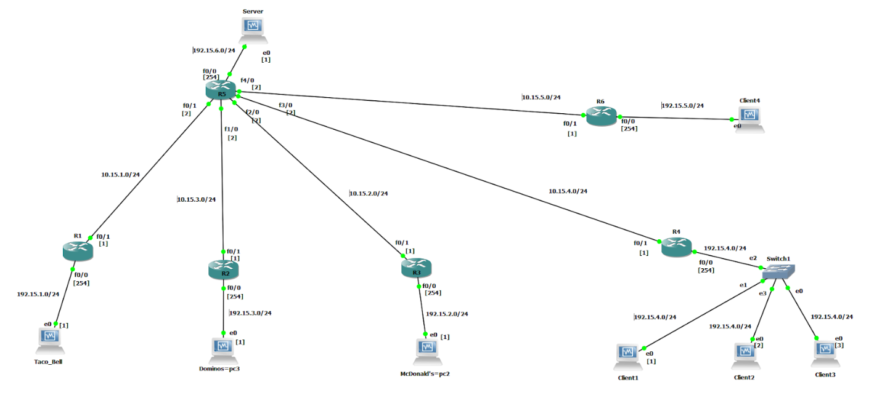
Our protocol
The way it works: The clients decides from which restaurant to order. He gets the menu, chooses what he wants from the menu, then he gets the estimated time too go pick up the order.
A client for QA
Clients
Restaurants
Notes:
לא יודע לצייר

Slide 4
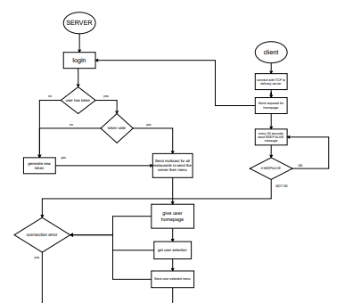
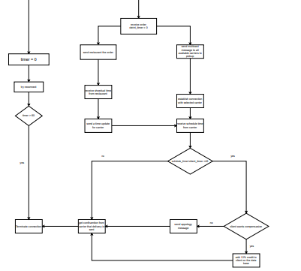
FSM
Notes:
בעייתי, מה נעשה?

Slide 5
Message Types

Slide 6
Wireshark examples

Slide 7
Timeouts

Slide 8
QA Test: Client connects with the wrong token

Slide 9
QA Test: Acceding maximum clients

Slide 10
QA Test: Trying to get a non-active restaurant menu keep-alive

Slide 11
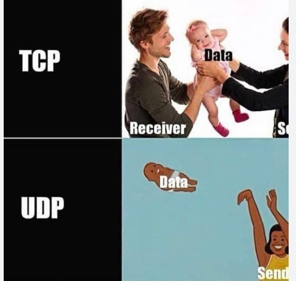
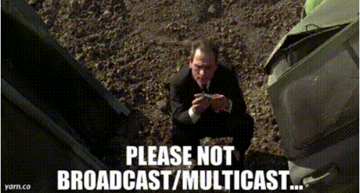
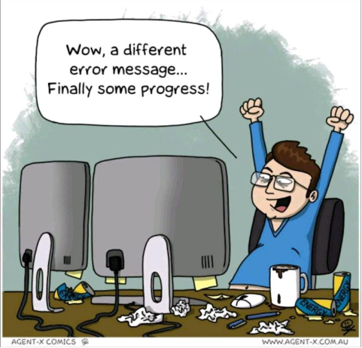
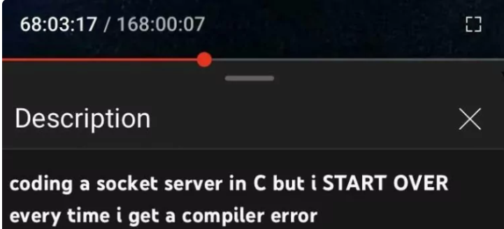
MEMES
POV: Us reading the assignment
I wanted to write a UDP joke, but you probably wouldn’t get it…

